Slide 1
Increasing the recovery of various vegetable oils

Slide 2
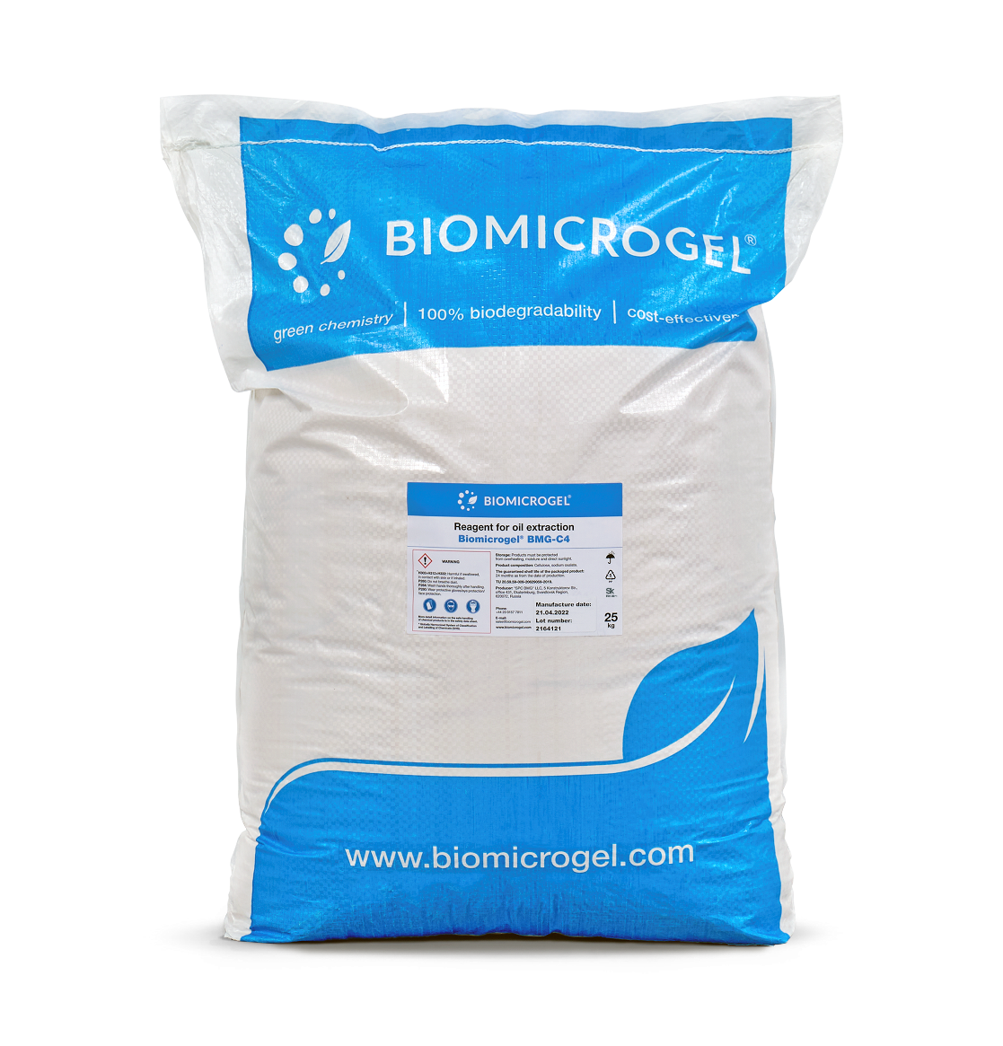
BMG-C4 IS DESIGNED TO INCREASE THE EXTRACTION OF VARIOUS VEGETABLE OILS
BMG-C4 is
Designed to increase the extraction of various vegetable oils during their production at the stages of settling and centrifugation.
Absorbed on solid organic particles (palm fruit cells) and forms thin polymer films on their surface that repulse oil droplets.
BAGS 25 kg

Slide 3
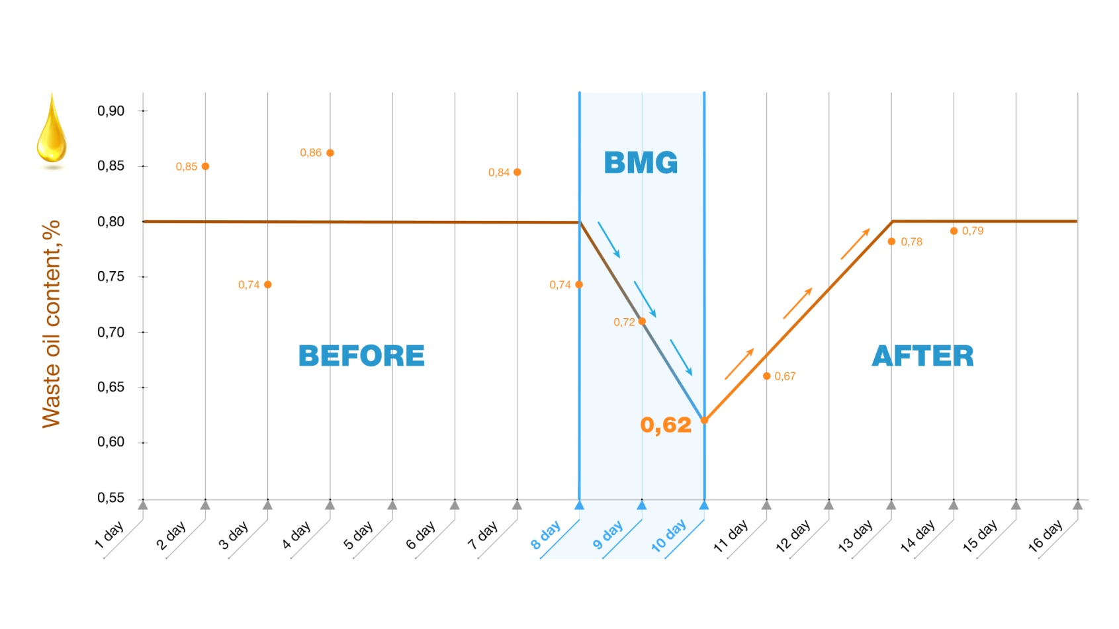
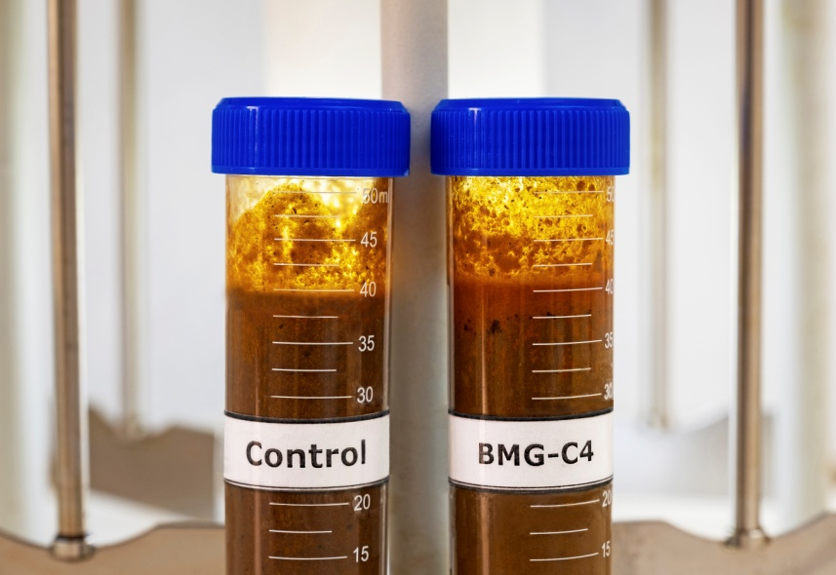
SOLUTIONS
The reduction of palm oil losses in wastes
OUR CLIENTS:
3
SGS Laroute

Slide 4
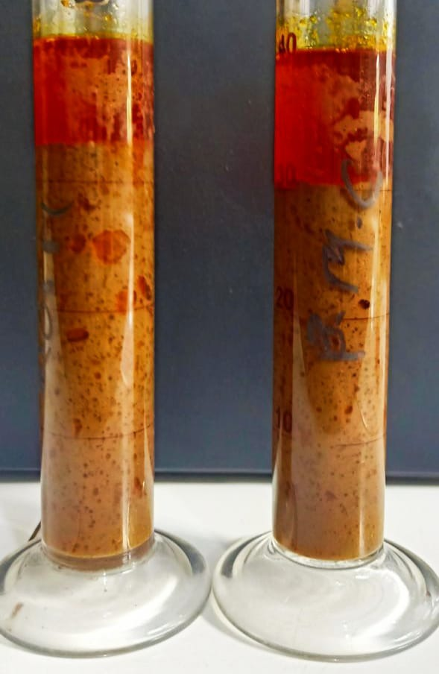
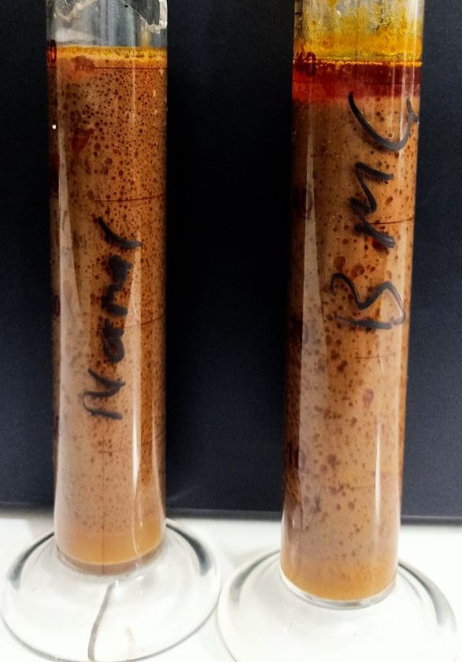
SOLUTIONS
COT sample
Underflow sample
BMG-C4 EFFECT DEMONSTRATED LAB TESTS
Increasing CPO extraction in COT sample by 28% after 75 minutes of settling.
8 mm of oil in underflow sample vs 0 mm in control sample after 60 minutes of settling.
BMG additional oil
Control sample
BMG sample
Control sample
BMG sample
4
SGS Laroute

Slide 5
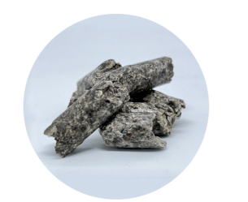
DESCRIPTION AND OPERATING PRINCIPLE
Biomicrogel® – is submicron polysaccharide particles obtained from by-products of agrifood industry: apple and beetroot pulp that possessing reversible solubility.
BMG-C4 is designed to increase the extraction of various vegetable oils during their production at the stages of settling and centrifugation stages. An aqueous solution of BMG-C4 has the property to separate oil from solid particles.
BENEFITS
Non-toxic, non-flammable, 100% biodegradable;
Applicable in the food industry;
Does not affect oil quality;
It reduced the oil loss in the production waste (water from the separator outlet) by 26% (from 0.84 to 0.62%);
Increasing by 7% of oil extraction rate in gravity settling processes.

Slide 6
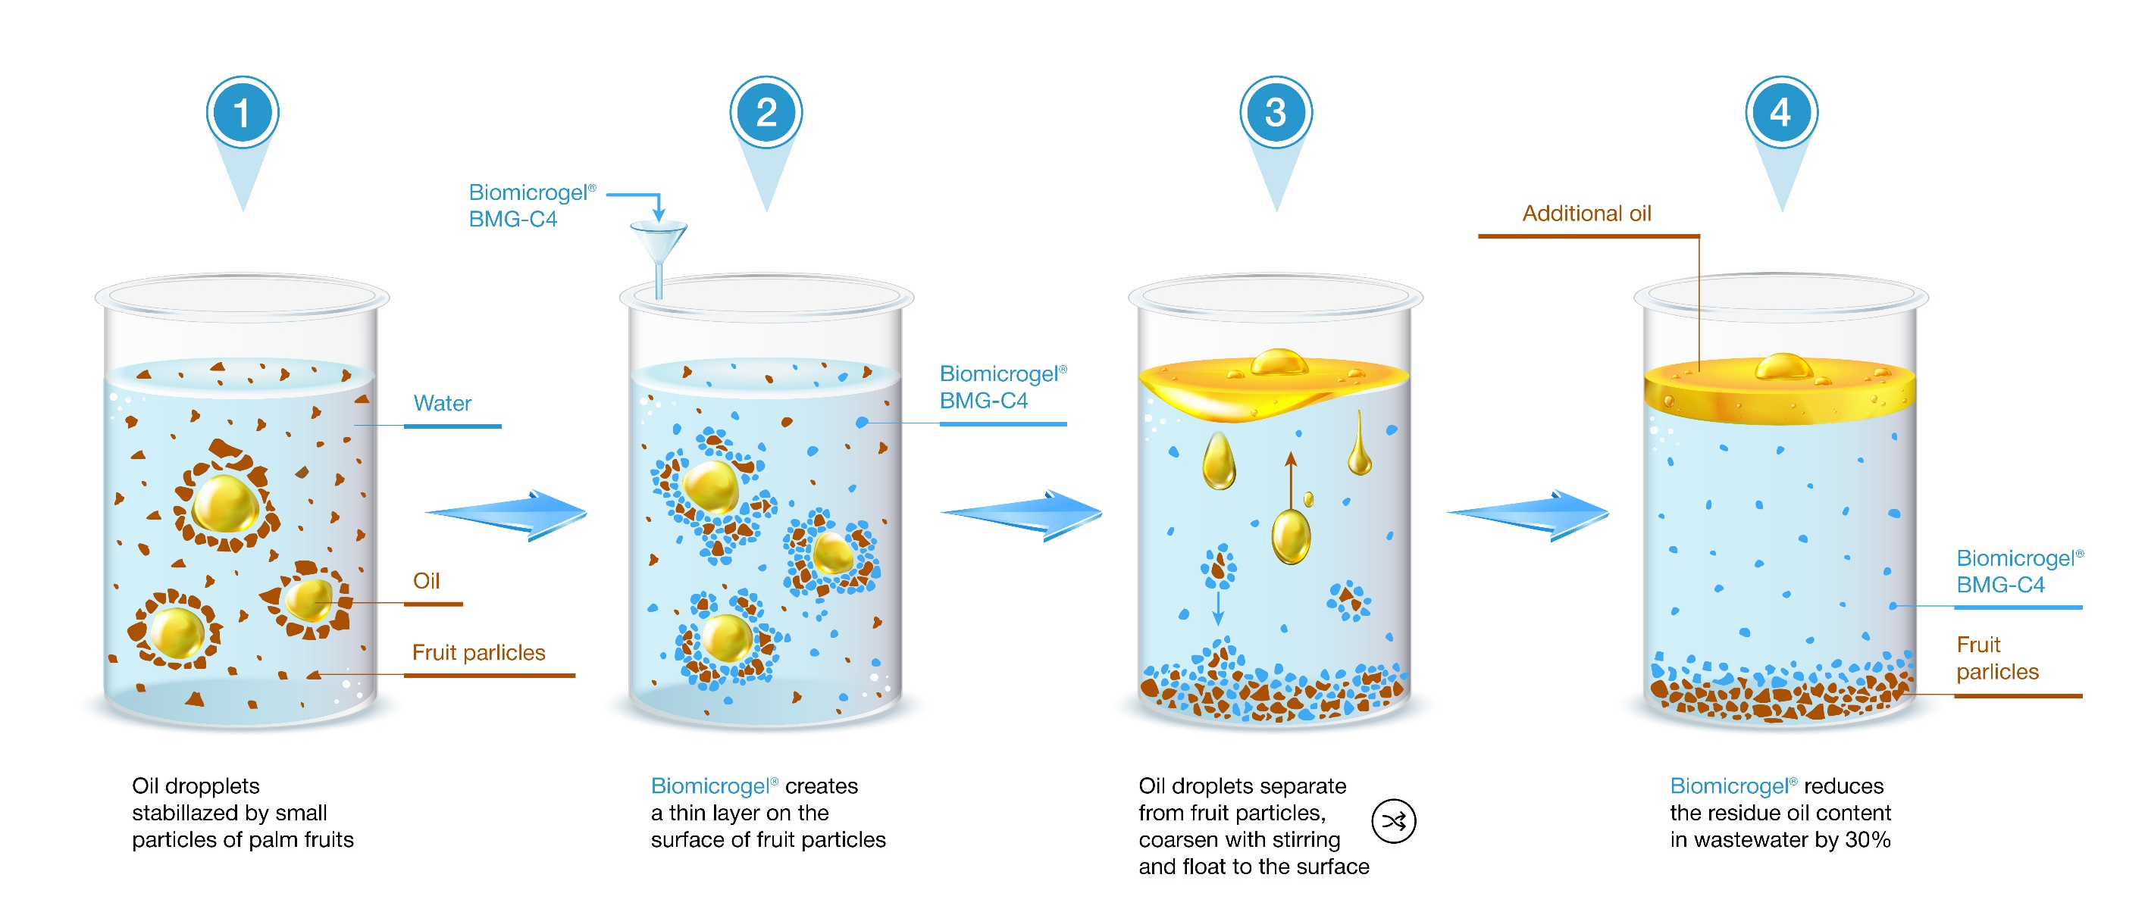
DESCRIPTION AND OPERATING PRINCIPLE

Slide 7
PHYSICAL PROPERTIES
DOSAGE
The optimal dosage of the BMG-C4 is from 0.3 to 1.0 g of BMG-C4 dry powder per 1 litre of non-oil sludge in DCO flow. BMG-C4 dosage is calculated based on the combined volume of water, non-oil-solid and emulsion, or volume of sludge minus oil volume.
It is recommended to add in the form of a 3% aqueous working solution. The volume of working solution BMG-C4 is from 10 to 33 ml per 1 litre of non-oil sludge in DCO flow.
Aggregate state | Fine-dispersed powder with inclusions of particles*
Color | Varies from beige to yellow-brown it is allowed the inclusions of white color*
Bulk density | 0.44 ÷ 0.70 g/сm³
рH value (3% water solution) | 1.25 ÷ 1.50
*- in case of a significant temperature drop during transportation and/or storage, BMG-C4
may stick together and darken, what does not affect the performance of the product.
APPLICATION
BMG-C4 is designed to increase the extraction of various
vegetable oils during their production at the stages of settling and centrifugation. An aqueous solution of BMG-C4 has the property to separate oil from solid particles. BMG-C4 is used as a 3% working solution.
PREPARATION OF THE WORKING SOLUTION
The working solution of BMG-C4 is prepared in a tank equipped with an overhead stirrer at a stirring speed of 100 rpm by dissolving an appropriate amount of dry BMG-C4 powder in tap water. The dissolution time varies from 10 to 30 minutes.
To prepare a working solution with 3 % concentration – take 30 kg of BMG-C4 dry powder, pour it into a mixing tank and add 970 litre of tap water. The recommended stirring time is 20-30 minutes, or until BMG-C4 is completely dissolved.
METHOD OF MEASURING RESULTS
Confirmation of the performance of BMG-C4 products is carried out by determining the residual oil content in waste (liquid and solid) after centrifugation stage.

Slide 8
STORAGE
After preparation, the working solution of BMG-C4 must be used within 7 days in order to avoid hydrolysis or bacterial or fungal growth and consequent loss of properties.
BMG-C4 is stored in the manufacturer’s package in ventilated warehouse premises protected from direct sunlight at a relative humidity of no more than 70% at a temperature not exceeding 37°C in conditions that exclude dust penetration and precipitation.
The guaranteed shelf life of the packaged product is 24 months as from the date of production.
UTILIZATION
BMG-C4 is disposed of in accordance with the current legislation.
Use a sealed container to collect wastes. Label it and utilize as Class 5 Hazardous Waste. Disposable or damaged containers utilize as household waste.
SAFE HANDLING MEASURES
WARNING
Н302+Н312+Н332 | Harmful if swallowed, in contact with skin or if inhaled.
Р260 | Do not breathe dust.
Р264 | Wash hands thoroughly after handling.
Р280 | Wear protective gloves/protective clothing/eye protection/face protection.

Slide 9
COMPETITIVE ADVANTAGES
 | BIOMICROGEL® BMG-C4 REAGENT FOR OIL EXTRACTION
High efficiency | Reduction of vegetable oil losses in wastewater up to 0.3%
Speed rate | Quick separation of oil from solids
Versatility | Stable at high temperatures No special water preparation required
Processability | The solution is easily integrated into an existing scheme
Biodegradability and eco-friendly | BMG-C4 does not cause negative environmental effect BMG-C4 is non-toxic water-soluble polymers based on natural raw material BMG-C4 does not affect oil quality
С-2

Slide 10
FLOWCHART OF APPLICATION OF THE REAGENT BIOMICROGEL® BMG-C4
Water
BMG-С4
Dissolution BMG-4
Dosing
Separation
Stock
Bioremediation
Oil

Slide 11
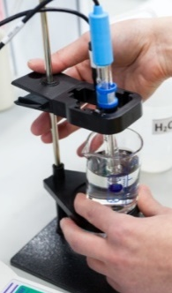
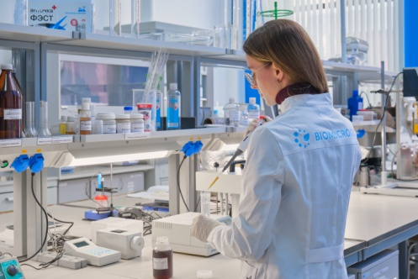
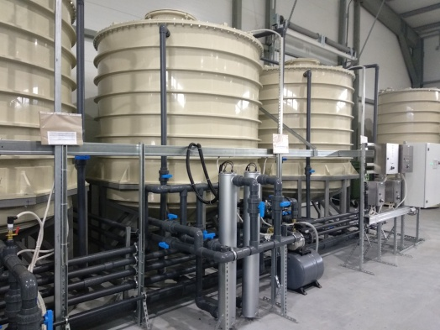
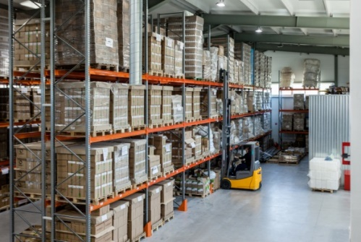
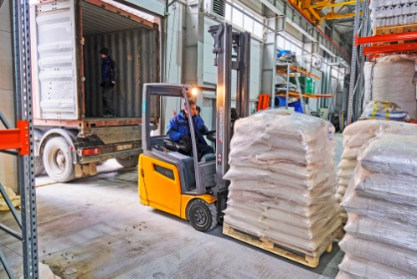
ABOUT COMPANY
Operates both in Russia and abroad:
South-East Asia, the European Union, the USA, Australia, and Brazil.
Developer and patent holder of solutions based on microgels under Biomicrogel® brand
(>100 patents, >60 countries).
2 production sites, 4 chemical laboratories and an experimental site.
Own an R&D facility, engineering department and technical support service.
Resident of the Skolkovo Innovation Center (Moscow, Russia).
Resident of “Nadezhdinskaya” Priority Development Area (Vladivostok, Russia).

Slide 12
ALL BMG PRODUCTS ALL BMG SOLUTIONS
Sorbent Biomicrogel® BMG-P1
Coagulant Biomicrogel® BMG-P2
Flocculant Biomicrogel® BMG-C2
Biomicrogel® BMG-C4 product for Increasing the vegetable oils extraction
Spilltex® dip net for petroleum products collection from water surface
Spilltex® filter cloth for laying sumps
Spilltex® filter barrier cloth for shallow rivers
Spilltex® universal filter cloth
Industrial and storm drains cleanup from oils, fats and petroleum products
Coolant processing in metallurgy and pipe rolling
Coolant processing in mechanical engineering
Performance gains in vegetable oil extraction
Oil and petroleum product spill cleanup
Purification of bottom and produced water

Slide 13
CONTACT DETAILS «SPC BMG», LLC
alpin.istanto@biomicrogel.com
+ 62 812 6060 1439
www.biomicrogel.com

